Slide 1
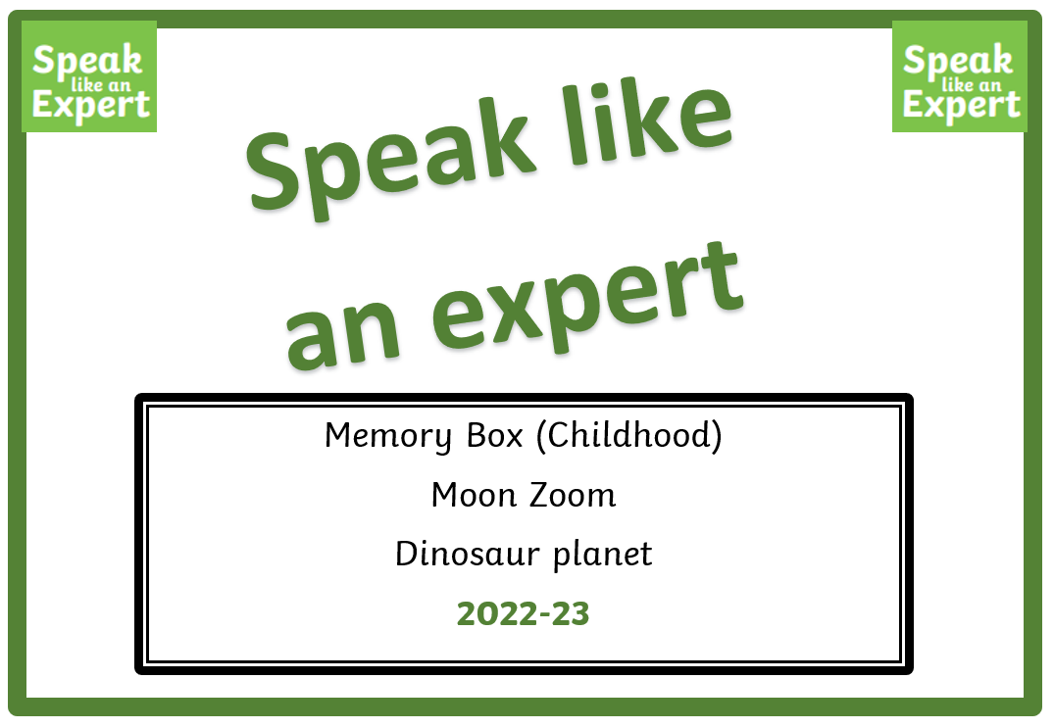
Year 1 and 2

Slide 2
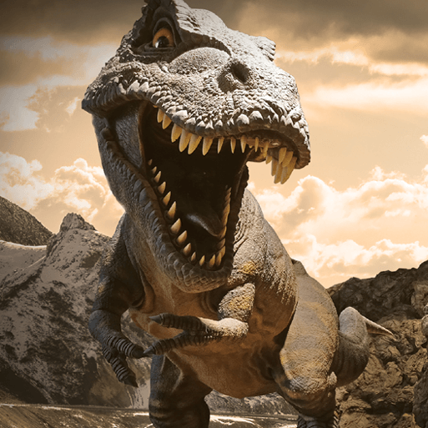
Dinosaurs
Planet

Slide 3
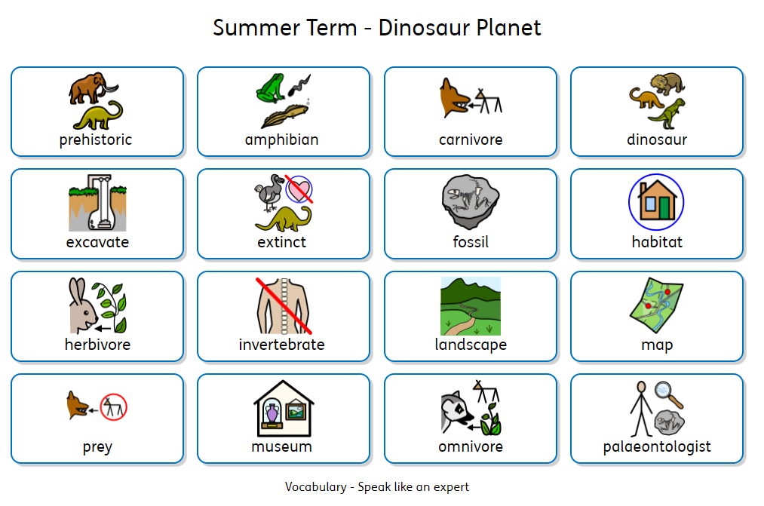

Slide 4


