Slide 1

YEAR 3 &4
SPEAK LIKE AN EXPERT
FROZEN KINGDOMS
SUMMER 2022

Slide 2









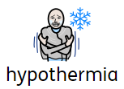






Slide 3
YEAR 5 & 6
SPEAK LIKE AN EXPERT
FROZEN KINGDOMS
SUMMER 2023

Slide 4






